Slide 1


Exploring the Future:
Energy and the Convergence of the Markets for Fuel, Food & Fibre
By
Don Roberts
Managing Director, CIBC World Markets Inc.
Don.Roberts@cibc.ca
Provincial Leadership Forum
B.C. Ministry of Forests and Range
November 2008

Slide 2
Outline
Context
Current Financial Meltdown
Energy
Convergence of the Markets for Food, Fuel & Fibre
So What?
Appendix: Global Fibre Prices
Notes:
2

Slide 3
Context
At the global level, the current changes in forest product markets and policies are the most fundamental we have seen since the end of the Colonial Era.

Slide 4
Context
Given these changes and the Mountain Pine Beetle Epidemic, many perceive that the B.C. forest industry is in crisis.
4
Notes:
17 November 2008
4

Slide 5
Current Financial Meltdown
Significant credit crunch. Difficult for even companies with strong balance sheets to operate.
U.S. housing recovery put off until 2011?
Good news: absolute inventory of unsold U.S. homes has been dropping.
Bad news: months of inventory has risen, and likely to stay bad due to a lack of financing for 1-2 years.
Still lots of macro-economic unknowns. Could we be facing a “lost decade” of growth like Japan experienced?
5
Notes:
17 November 2008
5
5

Slide 6
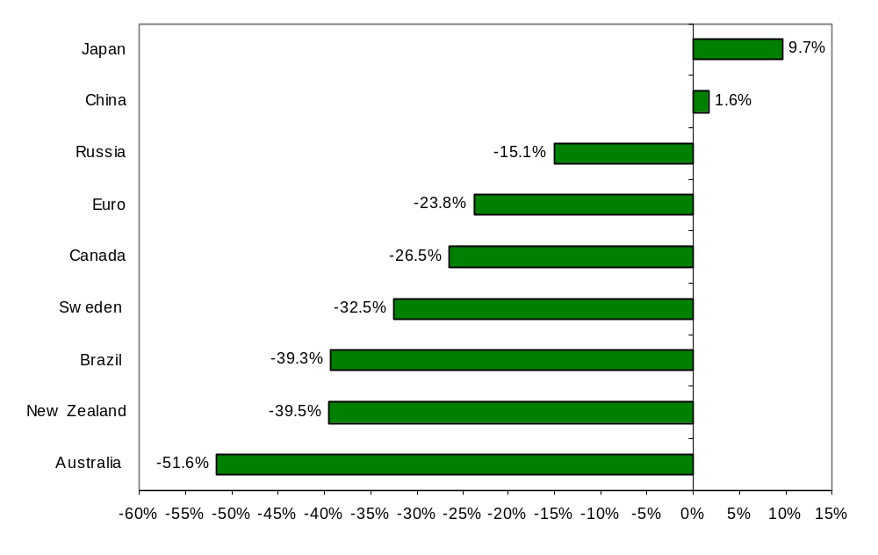
  Current Financial Meltdown
World Currencies Movement As Of October 24, 2008, (Vs. Q2/2008 Average)
$C has gotten hit against the $US….but some of our competitors have been hit even harder.
Generally good for our competitive position, but also puts downward pressure on $US prices.

Slide 7
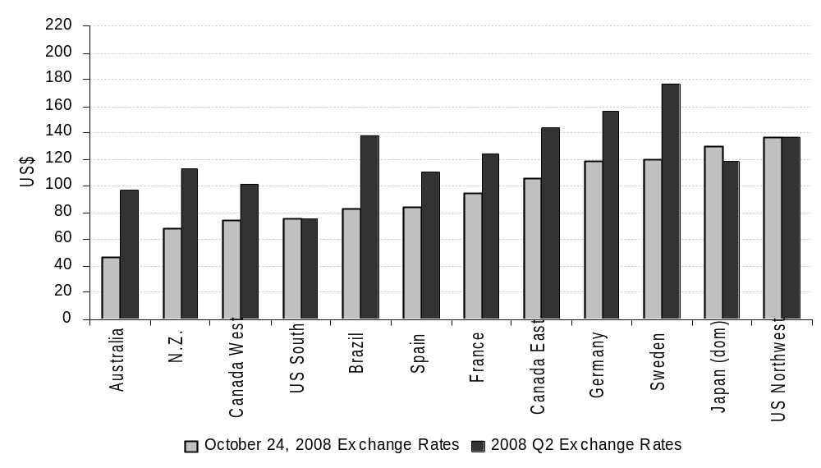
  Current Financial Meltdown
Average Delivered Conifer Pulpwood Prices: Before & After Recent Change in Exchange Rates
The change in currencies has shifted the global cost curve down – biggest drops in Oceania and Brazil, but B.C. is amongst the most competitive.
U.S. South still competitive, and U.W. PNW at the top of the curve.

Slide 8
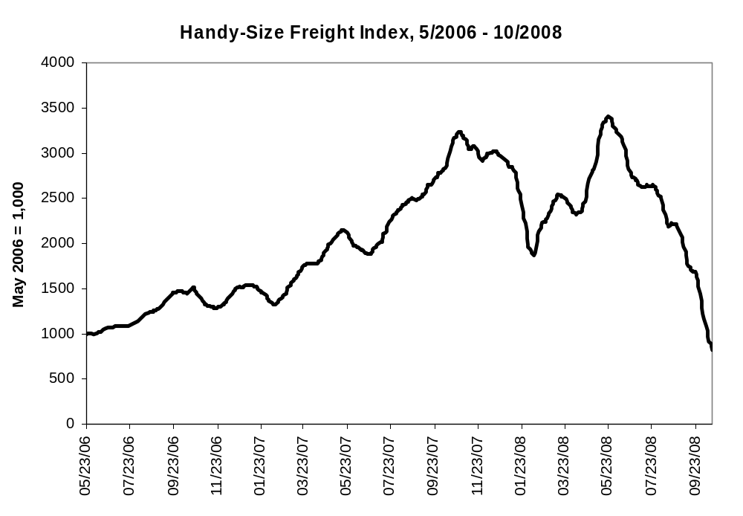
  Current Financial Meltdown
Cost of ocean freight transport has fallen through the floor.

Slide 9
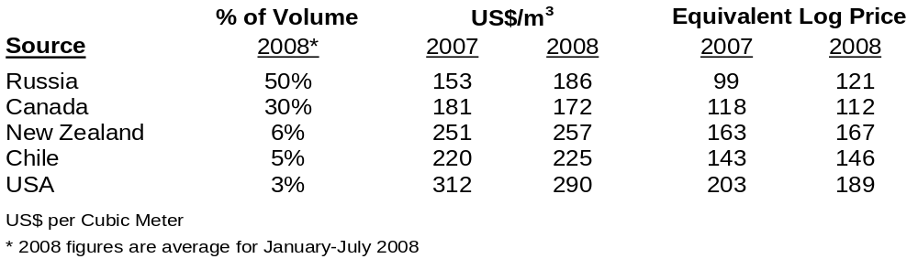
  Current Financial Meltdown
China’s Softwood Lumber Import Prices, 2007 And 2008
From a Chinese perspective, Canadian lumber is becoming a competitive substitute for Russia logs & lumber – even without the prospective increases in Russia’s log export taxes.
Recent exchange rate moves have improved Canada’s position vs Russia and USA.

Slide 10
Energy
and
the Convergence of the Markets for Fuel, Food & Fibre

Slide 11
Energy Demand
Global energy demand growing at CAGR of 2% implies a doubling in fossil fuel consumption in ~ 30 years. Does anyone think fossil fuel supply will double?
Our 3 price scenarios have oil at $65, $90, $150/barrel
Higher energy prices have a differential impact on the cost of producing forest products.
  Newsprint/groundwood papers and recycled paperboard are the most energy-intensive products.
  Kraft pulp and the solid wood products are the least energy intensive.
Higher energy prices also have a particularly negative impact on the cost of transporting bulky products
Notes:
11

Slide 12
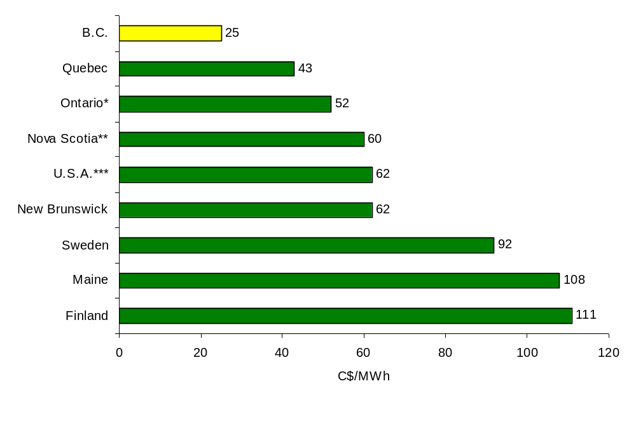
Electricity Prices For Large Industrial Power Customers, 2008
Electricity Prices
Source: Stantec
BC’s posted industrial electricity prices are amongst the very lowest in North America.

Slide 13
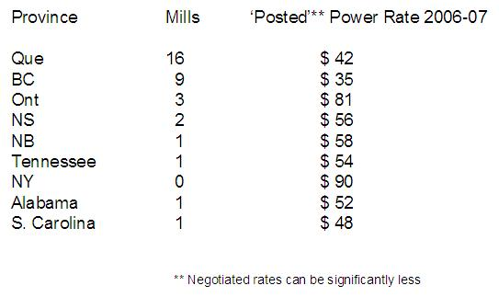
Mechanical Pulping TMP
Exposure of the Mechanical Pulp & Paper Industry
Source: Stantec
A pre-condition for significant mechanical pulping TMP capacity in a region is the availability of relatively low electricity prices.
There can be meaningful differences between posted and realized power rates across regions. Rates going forward?

Slide 14
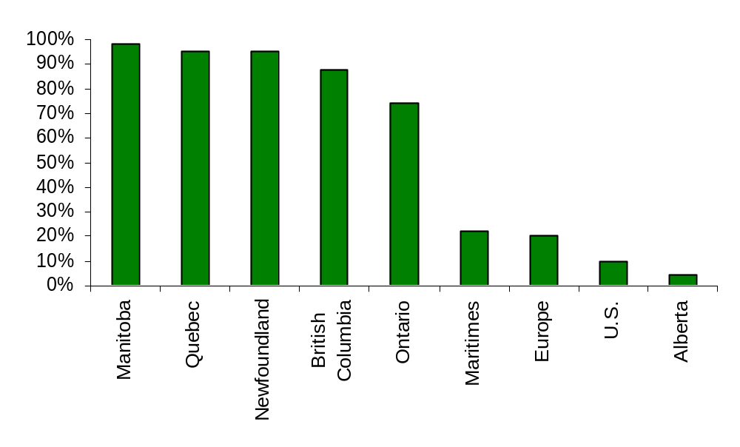
Regional Exposure to the Price of Carbon
Percentage Of Electricity Generated From Renewable and Nuclear Sources
Source: International Energy Agency and CIBC WM Economics
In a world of rising carbon prices, B.C.’s electricity prices are relatively protected, and your relative advantage should improve.
However, your transportation and heating demand is still exposed..
Notes:
17 November 2008
14

Slide 15
What Drives Investment?
Four key variables shape the economics of investing in alternative energy:
The price of fossil fuels (the main substitute)
The conversion technology
The cost of the feedstock (50%-80% of the variable cost)
Regulations (which stimulate demand)
At present, all four of these variables are in a state of flux.
Notes:
15

Slide 16
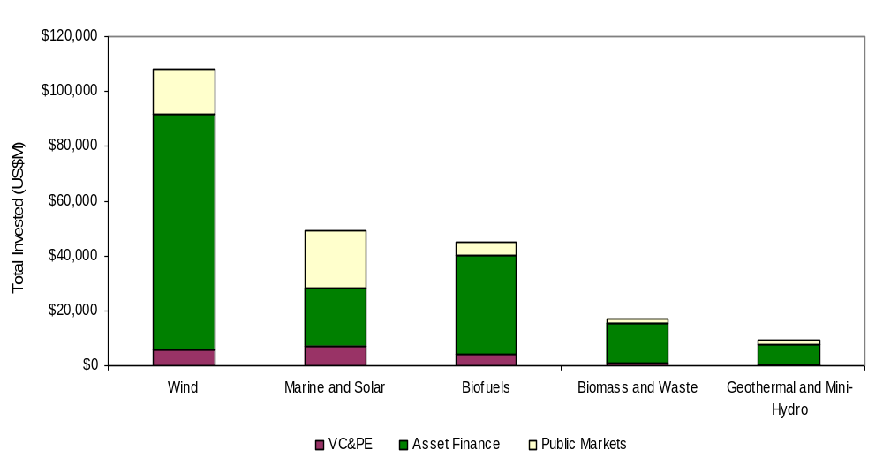
Global Clean Energy Financing, By Sector: Q1/05-Q3/08
Source: New Energy Finance and CIBC World Markets Inc.
- Bioenergy is not the only clean energy in town. Almost $250 billion invested in clean energy since the beginning of 2005.
– Biofuels is ~20%, Biomass/Waste ~7.5%. – Wind dominates with almost 50%.
- Almost $150 billion of new money raised in 2007 – a 60% increase over 2006.
Notes:
For example:
Revolution in electronic communication
Explosion of the Asian fiber deficit
Emergence of Russia
Convergence of the markets for fuel, food & fiber
Pricing of carbon
Decentralization of forest tenures

Slide 17
Implications Of Financial Crisis?
The ongoing crisis is moving beyond the U.S., and will affect the “real economy.”
Significant reduction in availability of capital to finance biofuel & biomass-based R&D and production – level of capital expenditures will likely remain lower for two to three years.
Slowdown in global growth will moderate recent rise in fossil fuel prices – weaken short-term financial incentive for alternative energy.
Given economic uncertainty, governments will likely ease off tightening environmental regulations in general, and renewable energy standards and carbon pricing in particular – worried about cost impact and the ability to finance related investments.
Notes:
17

Slide 18
Cyclical Or Secular Shock?
Significant cyclical contraction, but long-term arguments for biofuels are still intact.
Assuming growth in global energy demand of only 2%, fossil fuel demand is still expected to roughly double over the next 30 years. Does anybody expect the supply of fossil fuels to double?
Climate change will continue to be an issue, and the need to reduce our carbon footprint will remain.
Given feedstock prices as of mid-2008, many biofuel investments can still be justified even if the price of oil is in the US$70/Bbl-US$80/Bbl range.
During the cyclical contraction, expect large, well-capitalized energy and chemical companies to acquire smaller, more entrepreneurial and R&D-focused bio-energy companies.
Notes:
18

Slide 19
.
Convergence Of The Markets For Fuel, Food And Fiber
A key driver of the bio-economy.
Convergence is occurring for a range of reasons, but all related to security (and driven by anxiety):
  Environmental Security: i.e., combat climate change
  Economic Security: i.e., protection against the rising real price of oil
  National Security: i.e., diversification of energy supply
  Food Security: i.e., access to food at reasonable prices
  Political Security: i.e., secure political support at local level by rural development
Notes:
19

Slide 20
The Public Policies
What role is public policy playing in driving the convergence of the markets for fuel, food & fiber?
Consider a whirlwind global tour of bio-energy policies:
European Union
China
United States
Notes:
17 November 2008
20

Slide 21
European Union
Estimated 185 biodiesel plants already built, and 58 more under construction. Biomass-based power estimated to expand at 35% CAGR over 2005-2010 period.
The EU’s binding target for renewable content in transport fuel by 2020 is 10% (with a reduction to 6% proposed in Sept. 2008).
The EU-25 has agreed on a binding target to reach a 20% share of renewable energy source in total energy consumption by 2020 (currently ~7%):
  ~2/3 of the renewable energy is expected to come from biomass.
  If enforced, Poyry/McKinsey study forecasts a 200 million m³/year-260 million m³/year wood deficit in Europe in 2020.
  More recent ECE/FAO study forecasts a wood deficit of 320 million m³/year-450 million m³/year to meet both the energy objective and support a growing wood-based industry.
  If the target is enforced, expect meaningful upward pressure on global wood prices.
Notes:
17 November 2008
21

Slide 22
China
Ambitious target for renewables to account for 10% of all energy consumption by 2010 and 15% by 2020.
Biomass power targeted to grow from 2 GW in 2006 to 5.5 GW in 2010 and 30 GW by 2020 – largely with ag waste.
Need to build more than 1,000 biomass plants rated at 25 MW-30 MW by 2020 (~6/month).
Most facilities are direct combustion plants, but China Holdings is securing approvals to build five 100 MW pyrolysis/gasification plants.
Huge logistical challenge collecting 150,000 tpy-200,000 tpy of bulky straw from thousands of small 0.15 ha farms to fuel a 25 MW biomass power plant.
SFA targeting to develop 13.3 million ha of forests to produce feedstock for biofuel production and power – must compete with industrial wood and environmental demand.
Notes:
17 November 2008
22

Slide 23
United States
Renewable Fuel Standard in the Energy Bill requires 36 bln. gallons of renewable fuels by 2022, including 21 bln. gallons of “advanced” (non-corn starch) biofuels.
More than 65 major new wood energy projects identified, with the bulk being cogen, wood pellet, and then cellulosic ethanol.
Wood energy projects could consume 50 million tons/year of wood by 2012 and 70 million tons/year-200 million tons/year by 2020.
The forest industry in the Southern U.S. currently enjoys some of the lowest wood costs in the world. However, wood energy demand is a new long-term source of competition for U.S. wood supply – expect higher prices.
Notes:
17 November 2008
23

Slide 24
United States
President-Elect Obama has pledge to make clean energy his “number one priority” and invest $150 billion in the sector over 10 years to create 5 million “green collar jobs”. However, he will find himself handcuffed by challenging economic times and a massive federal deficit.
Legislation likely to be on the new Democratic majority’s agenda:
  National Renewable Portfolio Standard;
  Long-term extension of the Production Tax Credit for wind; and,
  Carbon cap-and-trade scheme (pass by mid-2009, but with relatively weaker requirements and lower targets)
Climate change rarely mentioned during Campaign ’08, but politicians in both parties regard the Clean Energy Sector as an economic development driver and key for energy independence.
Expect Congress to be more committed to growing wind, solar and other renewables sectors than in reducing emissions from existing fossil fuel-powered plants.
Notes:
17 November 2008
24

Slide 25
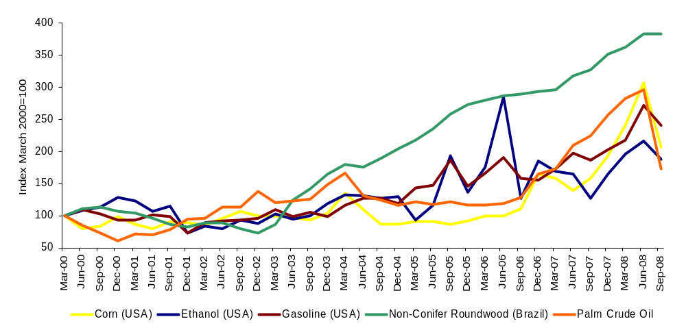
Biofuel & Feedstock Prices: Q1/2000-Q3/2008
Note: Non-Conifer Roundwood Q3/08 Index is estimated.
Source: Bloomberg, WRI and CIBC World Markets Inc.
    Convergence of the “3F” markets in the sense that the feedstocks will trade on the basis of their energy equivalency.
    The price of oil is expected to become a support price for cereals, oilseeds and lower-quality wood.
    Prices of all of the major feedstocks rose significantly, especially from 2006 to Q2/08 – outpaced gasoline & ethanol.
    Financial crisis has caused all of the biofuel and feedstock prices to fall, except wood in most regions - yet.
Notes:
17 November 2008
25

Slide 26
Shifts In Land-Use
Secular rise in fuel, food and fiber prices will trigger changes in land-use patterns.
Historically, land kept under forests for two main reasons:
Owners want the production of some non-market good or service.
The land can’t make it in agriculture.
Convergence is expected to have the largest impact in the southern hemisphere since they enjoy higher crop yields and have lower land and labor costs.
Notes:
26

Slide 27
Shifts In Land-Use
We think some of the best forest land will be under pressure for conversion to either food or bio-energy crops – especially in the tropics.
Expect greater land-use conflicts in many regions due to rising demand relative to potential supply.
Notes:
27

Slide 28
Where Is The Land Coming From — 2030?
How To Balance The Demand?
Availability
250―300 million ha
Industrial Forestry
25 million ha
Agriculture Demand
200 million ha
Bio-energy
290 million ha
Chemical Industry
?
Heat and Electricity ?
515+ million ha demand > 250-300 million ha supply
Source: S. Nilsson, IIASA.
Notes:
28

Slide 29
Wood Versus Other Cellulosic Biomass
Wood is one of many types of cellulosic biomass that can be used to produce biofuels.
However, wood does have the following relative advantages:
  Longer storage life and lower storage costs
  Higher bulk density (thus, lower effective transport costs)
  Higher sugar content
  Less intensive use of water & fertilizers
  Established collection system
Notes:
29

Slide 30
Dedicated Cellulosic Energy Crops?
  Miscanthus – a perennial grass – is likely the most interesting alternative.
  Can already produce 2.5x more ethanol per acre than corn.
    Green leaves arrive 6 weeks earlier, and stay 6 weeks longer
  Similar genome to corn, but is still unimproved. Potential for 3x increase in yield over time?
  Accumulates much more carbon in the soil since it is a perennial.
  Comparable growing season to switch grass, but much more efficient in converting sunlight to biomass.
  If harvested in December/January, after nutrients have returned to the soil, it requires little fertilizer.
  Is a sterile hybrid; thus, must be propagated by planting underground stems (rhizomes). Patented farm equipment can plant 50 acres/day.
Notes:
30

Slide 31

Implications of Convergence
So What?
Analytical Implications
Organizational Implications
Policy Implications
Investment Implications
Notes:
31

Slide 32
Analytical Implications
The key task is to move to cross-sectorial analysis and integrated land-use policies (break the “silo” mindset)
  Food/fiber/fuel/water/chemicals/climate/
  natural preservation―a real systems analysis approach
  But has this need arisen at a time when the analytical resources/capacity have actually diminished in both our industry and governments?
  More resources need to be dedicated to “thinking”
Notes:
32

Slide 33
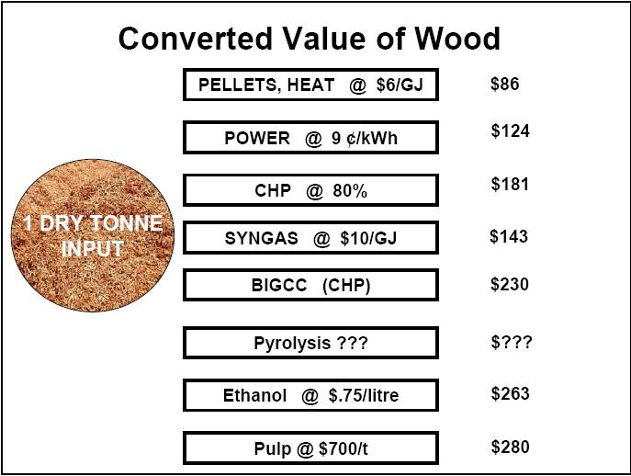

Analytical Implications
Source: CANMET Energy Technology Centre, NRCAN
Given recent prices, pellets generate the lowest revenue/ BDMT of wood – not good if wood is expensive.
More analysis needed: expand range of products and focus on cash flow and Return on Capital.

Slide 34
Analytical Implications
Current Status of Bio-energy Technologies
Hi Technology Risk LOW
Demonstration phases
R&D
Initial prototype
Pilot prototype
Commercial prototype
Market entry
Market penetration
Lots of competing technologies (and promoters)
Can you judge the risk/return trade-offs?
Combustion heat & power
BICC heat & power
Pyrolysis
Thermochemical transport fuels
Biochemical transport fuels
Source: Ceres Ventures.
Notes:
34

Slide 35
Analytical Implications
Generation Costs of Bioelectricity and Competing Conversion Technologies
180.00
Typical electricity cost range in $/MWh
160.00
140.00
120.00
100.00
80.00
60.00
40.00
20.00
0.00
Coal
Co-firing
Natural Gas
IGCC
Landfill Gas
Stirling Engine
Large steam cycle
Small steam cycle
Gasification (engine)
Anaerobic digestion
Gasification (turbine)
Note: Based on a biomass feedstock price of $11/MWh except for digestion and landfill gas plants where fuel cost assumed to be zero.
Source: IEA, Eubia
Bioelectricity is still not the low cost source… but the world is dynamic
Generally established technologies, but biggest future cost decrease likely associated with gasification (and increases with fossil fuels)
Large differences in costs within technologies = f(feedstock, scale)
Notes:
35

Slide 36
Analytical Implications
Feedstock & Scale:
Does the distributed nature of biomass preclude the achievement of economies of scale needed to profitably convert biomass to fuels & chemicals?
  Modern pulp & paper mill handles ~2 million BDMT of wood/year.
  World-scale 100-million-gallon cellulosic ethanol plant requires ~1.2 million BDMT of wood.
  Large petroleum refineries use as much as 19 million tons of crude oil/year.
Not necessarily, but it depends on the value of what is being produced.
The higher the cost of the delivered biomass, the more of an incentive to produce a higher-valued product (e.g., bio-chemicals).
Notes:
17 November 2008
36

Slide 37
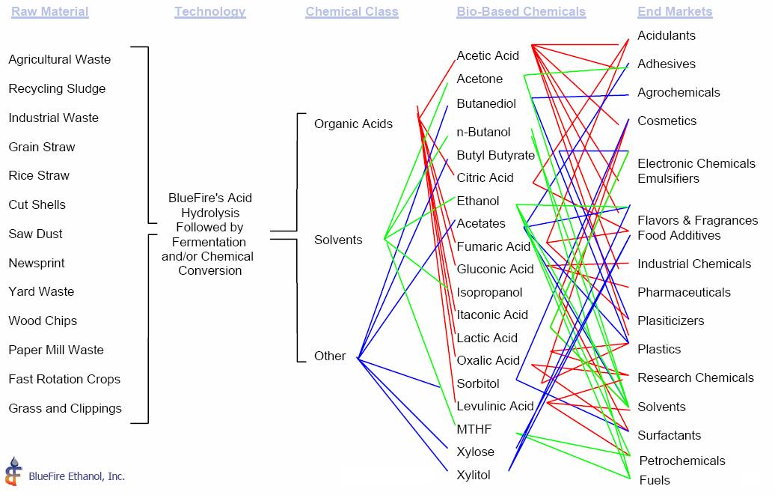
Technologies Already Exist Which Can Provide Competitive Entry into Bio-based Chemicals and Target Market Segments
Analytical Implications
Source: BlueFire Ethanol Inc.
If wood is expensive, need to produce higher valued products.
Many bio-chemicals can be produced, but the production and marketing is quite complex - need partners.
Notes:
37
37
“The delivered cost of biomass will remain a key variable determining which products should be produced, and thus the profitability of a bio-refinery. Given the long distances and low yields/ha which characterize the Canadian situation, my sense is that the most logical strategy for the Canadian mills is to focus on specialty chemicals. Otherwise, the revenue stream will ultimately not be sufficiently high to justify the high delivered price of fiber. In order to offset the competition from regions with lower cost fiber, we must also capitalize on our geographical advantage resulting from close proximity to customers. The fine-tuning of the supply chain is arguably more important in the higher valued specialty markets, and a greater barrier to potential entrants. At the end of the day, there seems to be no reason producers in Brazil can’t duplicate at least Phase 1 and 2 of your strategy.”

Slide 38
Organizational Implications
Need to break out of our sectorial silos
  At HQ, develop more “virtual” teams that cut across sectors.
  For forestry organizations (provided the big picture themes are understood and communicated), move the decision making closer to the land-base.
Notes:
38

Slide 39
Organizational Implications
To deal with these challenges, companies are having to realign the supply chain & play to their relative strengths.
Need for strategic alliances across sectors……
……further driving the convergence between the markets for food, fuel and fiber.
39
Notes:
17 November 2008
39

Slide 40
Organizational Implications
  Strategic Alliances:
  “Upstream” & Feedstock Companies
  Chevron/Weyerhaeuser for transportation fuels
  Neste Oil/Stora Enso for Fisher-Tropsch fuel
  Preem Petroleum/Sodra & Sveaskog for Fisher-Tropsch fuel
  Andritz (Carbona)/UPM-Kymmene for Fisher-Tropsch fuel
  Royal Dutch Shell/Cellana for bio-diesel
  ConocoPhillips/Tyson Foods for bio-diesel
Notes:
17 November 2008
40
WY – suggests we are a decade away before there will be a large scale use forest biomass for liquid fuel. Dow/Crystalsev building a 350,000 tpy commercial scale ethanol-based polyethylene plant in Brazil for 2011.

Slide 41
  Organizational Implications
Case Study:
Catchlight Energy - Weyerhaeuser & Chevron JV
  Formed in February 2008, with a focus on liquid transport fuels.
  Chevron provides expertise in molecular conversion, product engineering and fuel distribution.
  Weyerhaeuser provides land, expertise in resource management, and ability to provide feedstock at scale.
  Feedstock strategy:
    Inter-cropping: strips of S.Y. Pine & perennial grass
    Grass must not hurt quantity/quality of S.Y. Pine
    Grass harvested annually for 9 years before replanting
    Grass production of 10-20 BDMT/acre/year
Notes:
17 November 2008
41
WY – suggests we are a decade away before there will be a large scale use forest biomass for liquid fuel.

Slide 42
Organizational Implications
Strategic Alliances:
“Upstream” & Technology Companies
  – Royal Dutch Shell/Choren for Fisher-Tropsch fuel
  Royal Dutch Shell/Petro-Canada/Iogen for cellulosic ethanol
  Suncor Energy + Lignol for cellulosic ethanol
  Dupont + Genencor for cellulosic ethanol
  General Motors + Coskata for cellulosic ethanol
  UOP/Ensyn for pyrolysis-based transport fuels
Notes:
17 November 2008
42
SLIDE 32 IN Q:\FOREST\Presentations\PRESENTA\IB European marketing 2007 Book 1_DRAFT

Slide 43
Organizational Implications
Case Study:
UOP/Ensyn JV
  Formed in Q4/2008 with a focus on “drop-in” transport fuels
  UOP
    Owned by Honeywell
    Leading supplier & licensor of process technology, catalysts, absorbents, process plants and technical services to the petroleum refining, petrochemical & gas processing industries
    UOP technology furnishes 60% of the world’s gasoline, 85% of the world’s biodegradable detergents & 60% of the world’s para-xylene
    Strong relationships with leading refining and petrochemical customers worldwide
  Ensyn
    Most experienced producer of pyrolysis oil in the world
    Seven commercial plants in U.S. & Canada (max. 100 BDMT/day, but about to announce 400 BDMT/day)
    Operating since 1990
Notes:
17 November 2008
43
WY – suggests we are a decade away before there will be a large scale use forest biomass for liquid fuel.

Slide 44
  Organizational Implications
UOP/Ensyn JV (cont.)
  “Drop-in” transport fuel means the stabilized pyrolysis oil (bio-crude) can be upgraded and then processed in conventional refineries, moved over conventional pipelines and delivered to customers without blending with non-renewable resources.
  Build series of 3,000 BDMT/day plants, which feed into existing refineries (hub & spoke model).
    Scale of plant achieved
    Address decentralized nature of feedstock
    Cost-effective movement of the energy & chemicals in biomass
    Feedstock strategy:
    – Mixed woods and corn stover
  Expect to be commercial within three years
Notes:
17 November 2008
44
WY – suggests we are a decade away before there will be a large scale use forest biomass for liquid fuel.

Slide 45
Policy Implications
It depends –
are you a “Focused Fixer” or a “Paradigm Shifter”?
Notes:
45

Slide 46
Policy Implications
If you are a “Paradigm Shifter”, likely emphasize:
Need for dramatic reductions in consumption levels and changes in in consumption patterns among the wealthiest 10% of humanity (and altered expectations among most of the remaining populace)
Need to convince voters that the world has gone down the wrong path, and that we have to go back.
Does demanding such fundamental change divert attention from practical solutions? Is this possible, at least without a major crisis first?
Notes:
46

Slide 47
Policy Implications
If you are a “Focused Fixer”, likely emphasize:
Bio-engineering, especially to increase productivity and “robustness”
Agro–forestry–energy interface
Pasture improvements
Yield gaps between private and public lands.
Given the complexity of the issues, worth actively supporting the development of formal markets to address as many of the historical externalities as possible (eg., water, carbon, bio-diversity, etc).
Notes:
47

Slide 48
Policy Implications
When allocating publicly owned timber,
Be aware of the differences in Employment and GDP multipliers across end uses.
  For a given volume of wood, pulp & paper generates a GDP mulitiplier 8x and Employment multiplier 13x that associated with pure energy (but also consider distributional differences)
Keep your tenure arrangements flexible to allow inter-cropping (eg, Chevron/Weyerhaeuser model)
Pyrolysis technology is attractive, but “hub & spoke” model may result in the bulk of the value-added getting siphoned out of the forest sector.
Notes:
48

Slide 49
Policy Implications
At the global level, there is a clear trend toward the devolution of forest management authority – it is becoming less centralized.
More than three-quarters of developing countries are now undergoing decentralization and devolution processes, shifting public authority from central to local government bodies and from government to the private sector and civil society
Over the past decade, the area of forest over which community control is legally recognized has doubled.
Communities now legally own or administer at least 380 million ha of forest, mostly in developing countries.
In the last 2 years alone, new tenure policies or legislation have been adopted in Brazil, Bolivia, China, Indonesia, India and Russia.
Notes:
49

Slide 50
Policy Implications
  How can we structure the tenure arrangements so that:
    The right fiber goes to the right mill?
    Facilitates the cost efficient collection of biomass?
  At the same time, the tenure system should be sufficiently flexible in accommodating new technologies (and players) who may be more efficient – the bioenegy field is very dynamic.
Notes:
50
50

Slide 51
Policy Implications
Two key guidelines for public policy re bio-energy markets:
In terms of strict energy perspective, it is more efficient to use biomass in heat and electricity production than for biofuels.
  Conversion losses of 10–20% for H&E;
  Conversion losses of 30-65% for biofuels.
When allocating public wood, note the differences in economic multipliers:
  For 1 m3 of wood, relative to BioEnergy, Pulp & Paper generates (based on European data):
    8x more GDP;
    13x more Employment.
Notes:
51
51

Slide 52
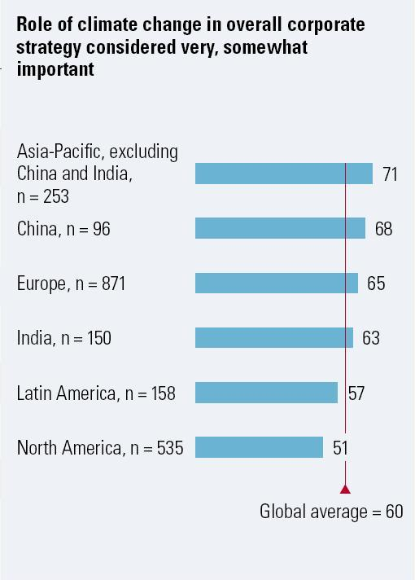
Investment Implications
A McKinsey Global Survey: How companies think about climate change
Surveyed 2192 C-level executives around the world (27% CEOs), Dec 07.
Fully 60% regard climate change as strategically important, and a majority consider it important to product development, investment planning and brand management.
Importance greatest in Asia/Europe, and least in North America.
Source: Dec 2007 McKinsey Quarterly survey on climate change
Notes:
52
P –
Insert a bar chart like what appears on the right side of Exhibit 1 from the McKinsey report, page 3

Slide 53
Investment Implications
Good quality land will be the scarce resource.
...and access to clean water may be key in influencing the quality.
Owners expected to lobby for flexibility in switching land uses
Notes:
53

Slide 54
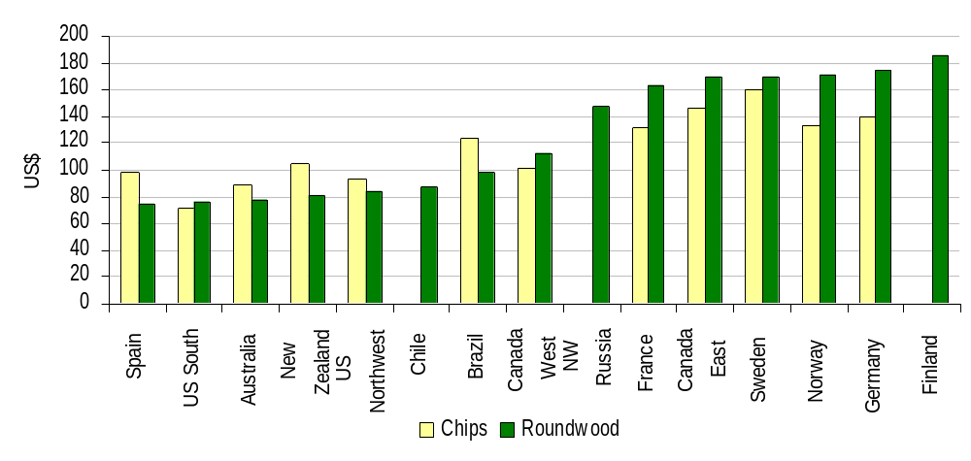
Investment Implications
Average Delivered Price of Conifer Pulpwood (Q4/07)
We think the convergence of the “Three F’s” (in combination with four other “shocks”) are going to cause the global cost curve for fiber to shift up and flatten.
Declining spread in wood costs across regions means other variables will increase in relative importance when assessing location of investment.
Comparative advantage shifting back to the Northern Hemisphere?
Notes:
54
54

Slide 55
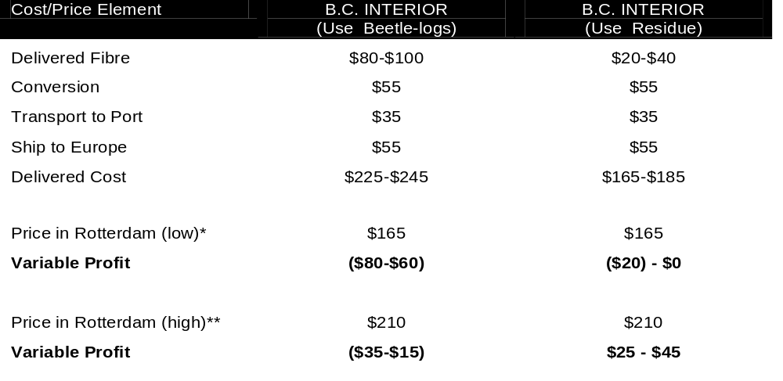
Comparative Financial Analysis of B.C. Wood Pellet Plants: Sawmill Residue vs Beetle Logs ($/ODMT) Q1/2008
Investment Implications
* Based on an exchange rate of €105 at $1.56/ €.
** Based on an exchange rate of €135 at $1.56/ €.
B.C. Interior pellet capacity expected to expand from 0.9 million tpy in 2007 to ~ 3 million tpy in 2010, with vast majority of output destined for Europe. Questionable economics if based on Beetle wood.
Delivered fibre cost estimated to be $20-40/ODMT for sawmill residue, versus $80-$100/ODMT for “Beetle Wood”. (Unit fixed costs of ~$20/ODMT should be added, with the estimate higher for plants smaller than 120,000 ODMT).
Normalized CHP pellet prices expected to range from 105-135 euro/ODMT, CIF Rotterdamn. 3-year contract currently ~130 euro/ODMT.
Notes:
55

Slide 56
Investment Implications
Fact: Transportation costs are key to obtaining a competitive delivered cost of biomass
Case Study: 5,000 BDMT/day biorefinery
Assume the forest base is a circle, and the biorefinery is in the middle.
Given yield of 2 BDMT of biomass/acre, the haul distance radius is 58 miles to feed the mill – not economic.
If you can increase the yield to 10 BDMT/acre, the haul distance falls to 22 miles - economic.
With 10 BDMT/acre, can feed a 10,000 BDMT/day biorefinery with an average haul distance of 30 miles – more economic.
Message? Increasing yield/acre is key to achieving competitive delivered biomass costs and attaining economies of scale in processing.
56
Notes:
17 November 2008
56

Slide 57
Investment Implications
Given the current environment, it is estimated that it costs roughly 12 cents per ton mile to transport biomass. Moving biomass more than 80 km can dramatically reduce profits.
There is a distinct cost advantage if the biomass is already at the plant site, and a joint-product can be made. Joint products may include pulp & paper, bio-chemicals, etc.
Notes:
17 November 2008
57

Slide 58

Central to all bio-energy strategies is a competitive price for delivered biomass
Thank you.
58
Notes:
17 November 2008
58
58

Slide 59
Appendix A: Global Fibre Prices
Notes:
59

Slide 60
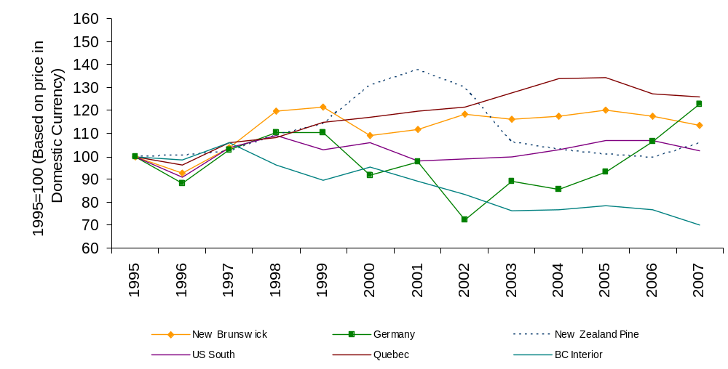
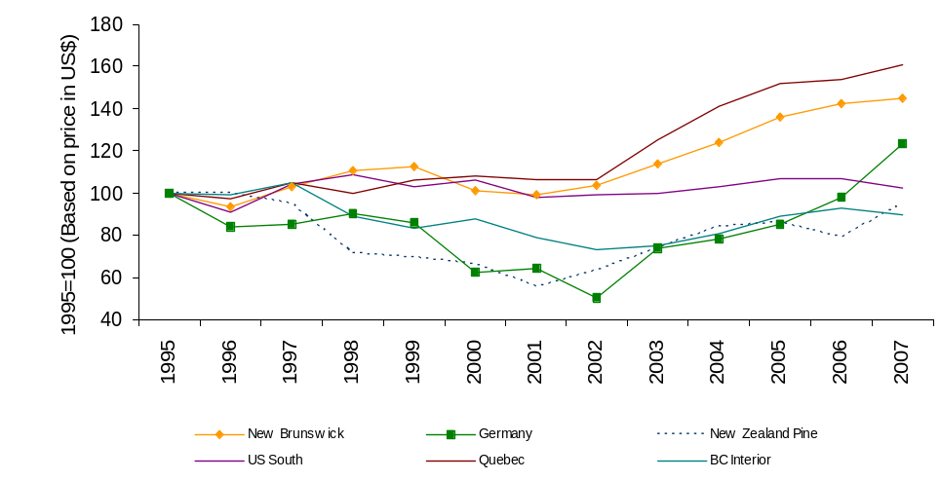
Delivered Conifer Sawlog Price Index
(1995-2007) (Domestic Currency)
Globalization of Fiber Markets
Delivered Conifer Sawlog Price Index
(1995-2007) (USD)
Source: Wood Resources International, CIBC World Markets Inc.
Price indexes are a reasonable indicator of changing economic scarcity.
Since 1995, sawlog prices in the BC Interior have increased the least (regardless of currency)
…..while those in Quebec have risen the most.
Since 2002, sawlog prices in Europe have moved sharply upwards – more than offsetting the declines from 1995-2002.

Slide 61
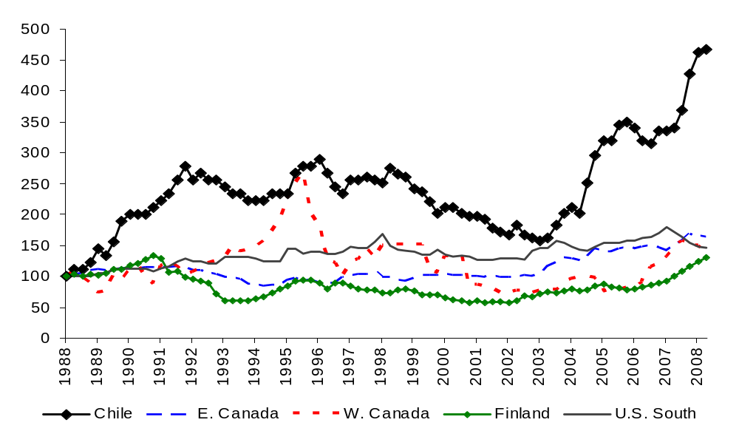
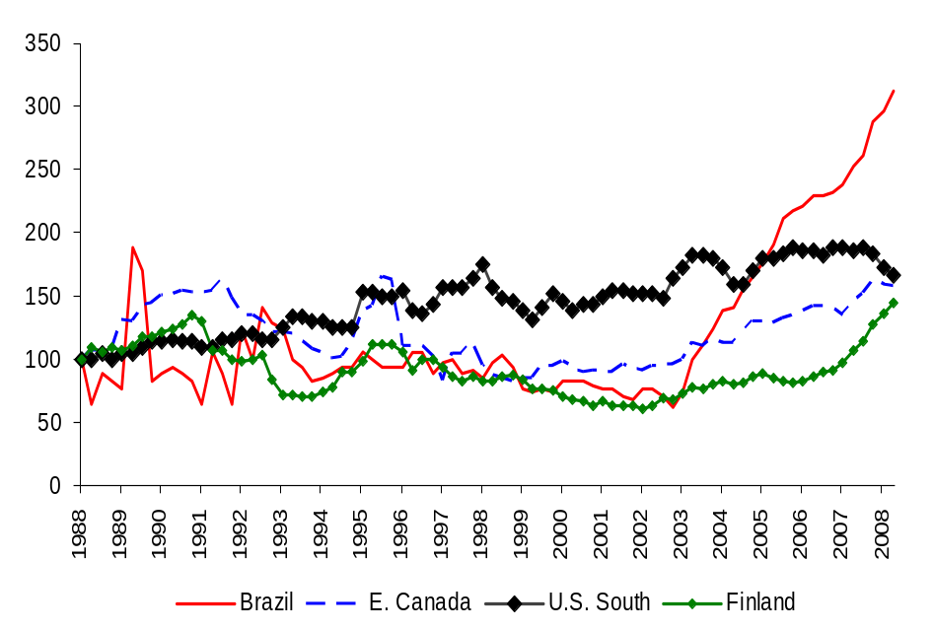
Nominal US$ Price Indexes of Conifer Pulpwood: Regional Comparison
Globalization of Fiber Markets
Nominal US$ Price Indexes of Non-Conifer Pulpwood: Regional Comparison
Source: Wood Resources International, CIBC World Markets Inc.
“Low cost competitors” in S. America have been experiencing a dramatic increase in their relative cost of market wood since 2003/4 – partly offset recently due to exchange rate changes.
We are still seeing upward pressure on European domestic prices.

Slide 62
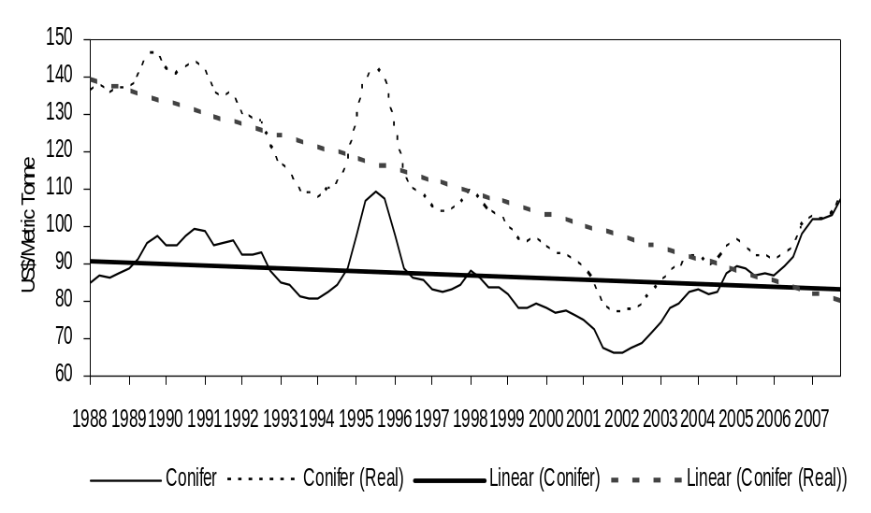
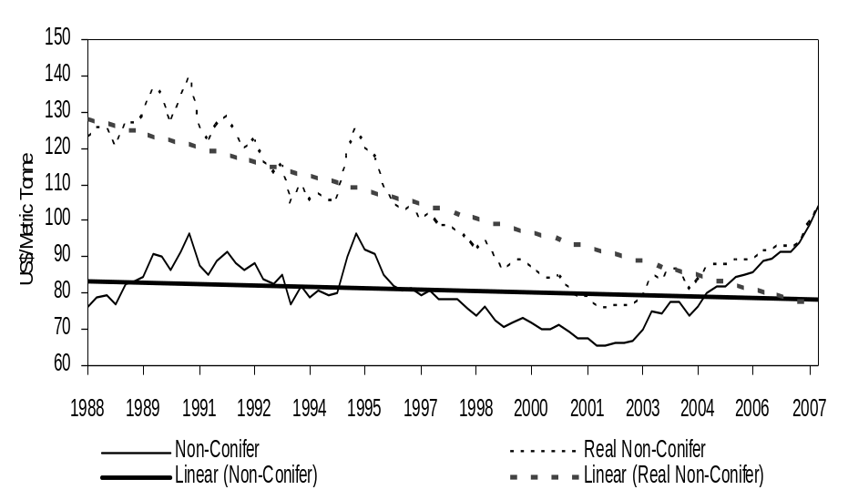
Global Average Prices for Conifer Pulpwood
Globalization of Fiber Markets
Global Average Prices for Non-Conifer Pulpwood
Source: Wood Resources International, CIBC World Markets Inc.
At the global level, real pulpwood prices have been on a secular decline. (One reason real pulp & paper prices have been declining)
But prices are starting to increase.

Slide 63
Globalization of Fiber Markets
We are likely at an inflection point regarding the perception of scarcity.
The combination of 5 shocks will likely shift the perception at the global level from “relative abundance” to “relative scarcity” of wood fiber:
Continuing Growth in Asia’s Wood Deficit
Increase in Russian Log Export Tax
Reduction in Supply of Illegal Logs
Insect Infestation in Western Canada
Growth of the Bio-energy Sector
Notes:
63

Slide 64
Globalization of Fiber Markets
  Summary
  Secular increase in wood demand due to:
  Growing fiber deficit in Asia.
  Developing bio-energy sector.
  Decrease in wood supply due to:
  Increase in Russian log export tax.
  Reduction in supply of illegal logs.
  Insect infestation in Western Canada.
  Expect rising trend in real wood prices through 2020
  (subject to cyclical swings).
Notes:
64

Slide 65
Appendix B: Bio of Don Roberts
Mr. Roberts is a Managing Director with CIBC World Markets Inc., an investment bank with 23 offices around the world and over 2,600 employees. He leads CIBC’s Paper & Forest Products Research Team, and is also responsible for the bio-fuels sector. His primary responsibility is to lead a team of analysts in advising financial institutions (e.g., pension/mutual funds) on their investments in the global paper & forest products industry. He is consistently ranked by institutional investor surveys as one of the top equity research analysts covering the forest products industry.
Mr. Roberts specializes in international commodity markets, and has collaborated with a number of international forestry organizations to gain a global perspective on the paper & forest products sector. He has over 30 years of experience related to various aspects of the forest products sector. Prior to joining the investment business, he was Chief of Industry and Trade Analysis with the Canadian Forest Service.
In addition to his work with CIBC World Markets Inc., Mr. Roberts is also
  An Adjunct Professor in the Department of Forest Resource Management at the University of British Columbia (Vancouver);
  On the Board of Executives of the Sloan Center for Paper Business and Industry Studies at the Georgia Institute of Technology (Atlanta, Georgia); and
  Serves in an advisory capacity for a range of government, industry, and NGO groups.
Mr. Roberts has a Bachelor’s degree in Agricultural Economics from the University of British Columbia, a Master’s degree in Forestry Economics from the University of California at Berkeley, and both an MBA and doctoral studies in International Finance and Economics from the University of Chicago.
Notes:
65

